Slide 1
Water Resources Assessment Theme 1: Water Availability
Wandile Nomquphu
Date: 11-12 September 2024
University of Mpumalanga

Slide 2
A) Strategic Theme Objectives
To ensure sustainable water availability across all scales and contexts; and
To produce innovations that resolve water availability challenges & improve water management practices.
Water Availability = Anthropogenic demand + Environmental functioning + Unallocated water resources

Slide 3
b) Strategic Focus Areas & Outputs
Four interlinked strategic focus areas and outputs will form the basis for the thematic area that supports the strategic outcomes of the WRC.
Build Climate Resilience
Develop advanced monitoring and modelling tools to assess water availability, predict water scarcity, flooding and facilitate informed decision-making.
Enhance water conservation practices through the development of smart technologies and devices, climate resilient infrastructure, policies, and user empowerment.
Develop Alternative Supply Sources
Develop comprehensive studies and tools to assess the availability and distribution of water resources at different scales.
Explore technologies and infrastructure to expand access to freshwater resources in water-stressed regions.

Slide 4
Strategic Focus Areas & Outputs
Enhance Sustainable Water Management
Develop innovative localised and context-driven water management strategies and water balance optimisation, integrating demand management, water reuse, and integrated water resources management approaches.
Conduct socioeconomic studies to understand the implications of water scarcity on communities, livelihoods, and economic development, and develop strategies for equitable water allocation.
Enhance knowledge about the importance of water availability, conservation, and responsible water use.
Develop platforms for water and related data to improve decision-making and planning
Promote Ecosystem Protection
Enhance the protection and use of blue and green infrastructure.
Ensure the mainstreaming of Strategic Water Source Areas in by-laws and policies.
Promote the adoption of nature-based solutions for water availability, such as rainwater harvesting, green infrastructure, and catchment restoration.

Slide 5
To ensure sustainable water availability across all scales and contexts; and to produce innovations that resolve water challenges & improve water management practices.
Strategic Thematic Objectives
Focus
Area
Build Climate Resilience
Develop New Supply Sources
Enhance Sustainable Water Management
Promote Ecosystem Protection
Advanced climate monitoring and modelling tools
Studies and tools to assess the availability and distribution of water resources at different scales
Innovative localised and context-driven water management strategies
Protection, integration and use of blue and green infrastructure
Outputs
Smart technologies and devices, climate resilient infrastructure, policies, and user empowerment
Socioeconomic studies to understand the implications of water scarcity
Mainstreaming of Strategic Water Source Areas in by-laws and policies
Technologies and infrastructure to expand access to freshwater resources in water- stressed regions.
Enhance knowledge about the importance of water availability
Adoption of nature- based solutions
Outputs are changes in skills or abilities and capacities of individuals or institutions, or the availability of new products and services that result from the completion of activities within a development intervention within the control of the organisation.
Platforms for water and related data

Slide 6
c) Threats to Water Security (Water Quantity and Quality Stressors)
e.g. Urbanisation, population growth, competing water users, climate change

Slide 7
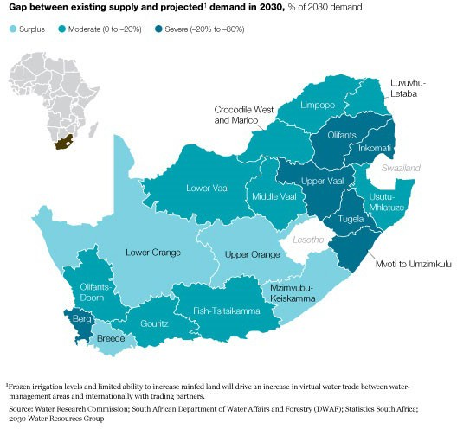
d) Threats to Water Security (Water Quantity and Quality Stressors)
i) Supply vs Demand
Projected water deficit in Mpumalanga Province by 2030.
Projects:
A dynamic water balance model to improve water security in the Steve Tshwete Local Municipality
etc

Slide 8
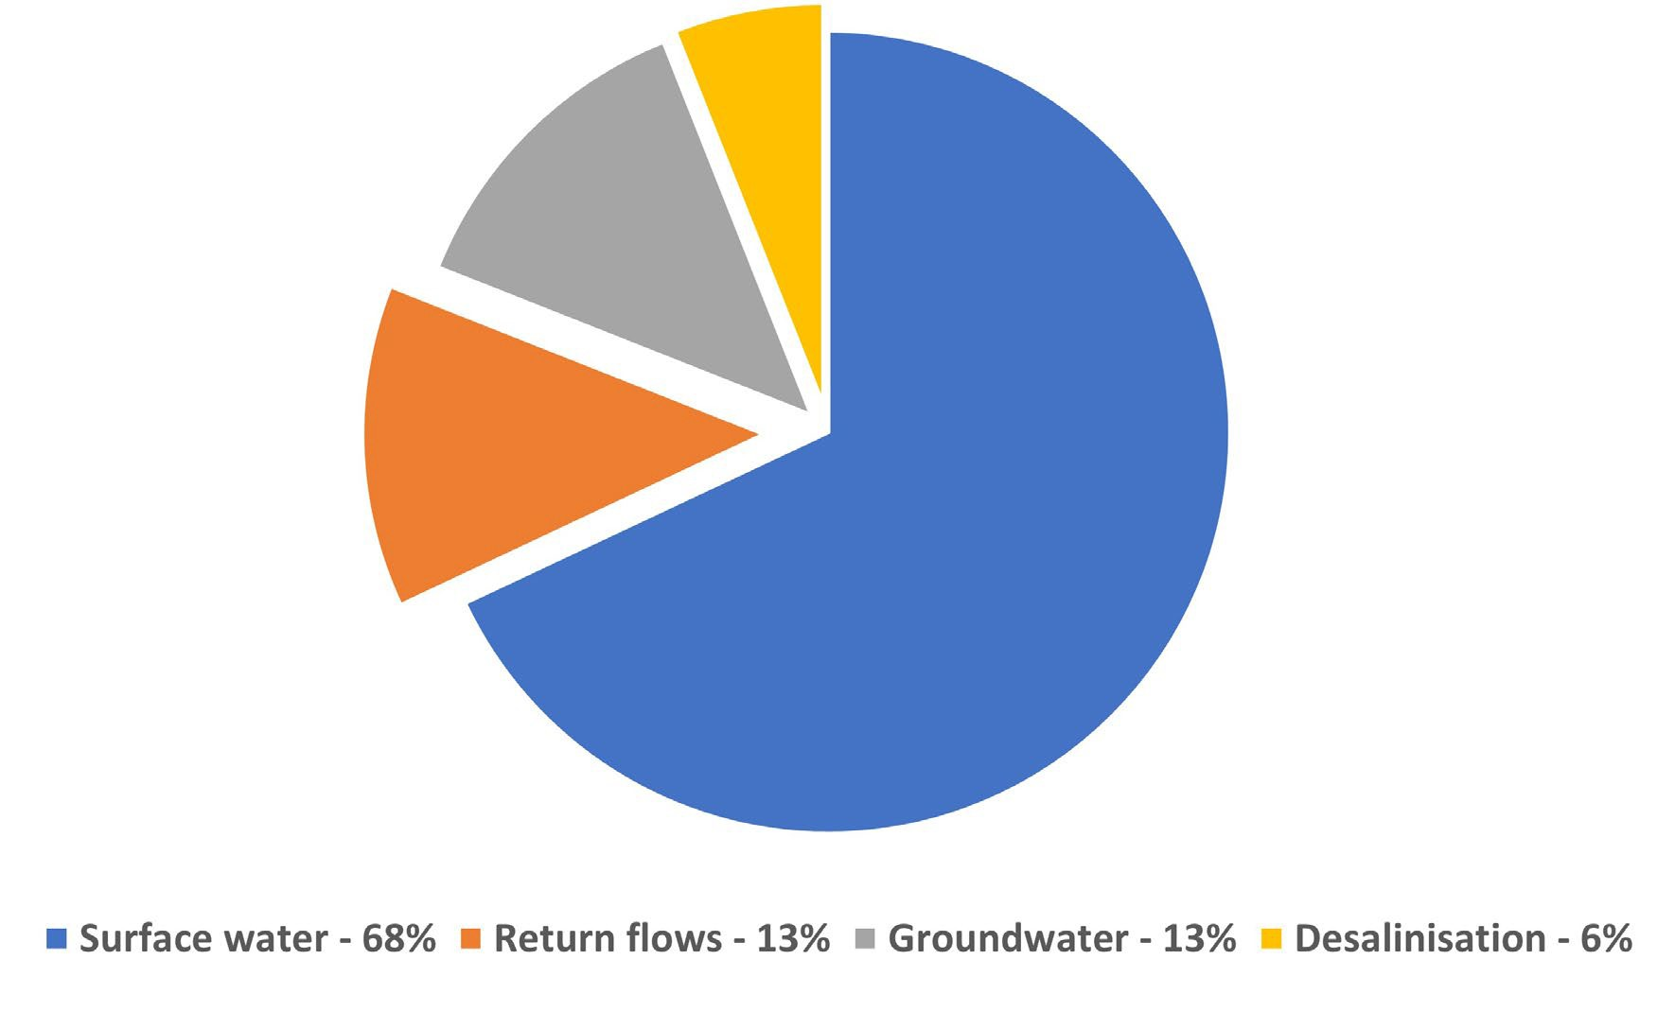
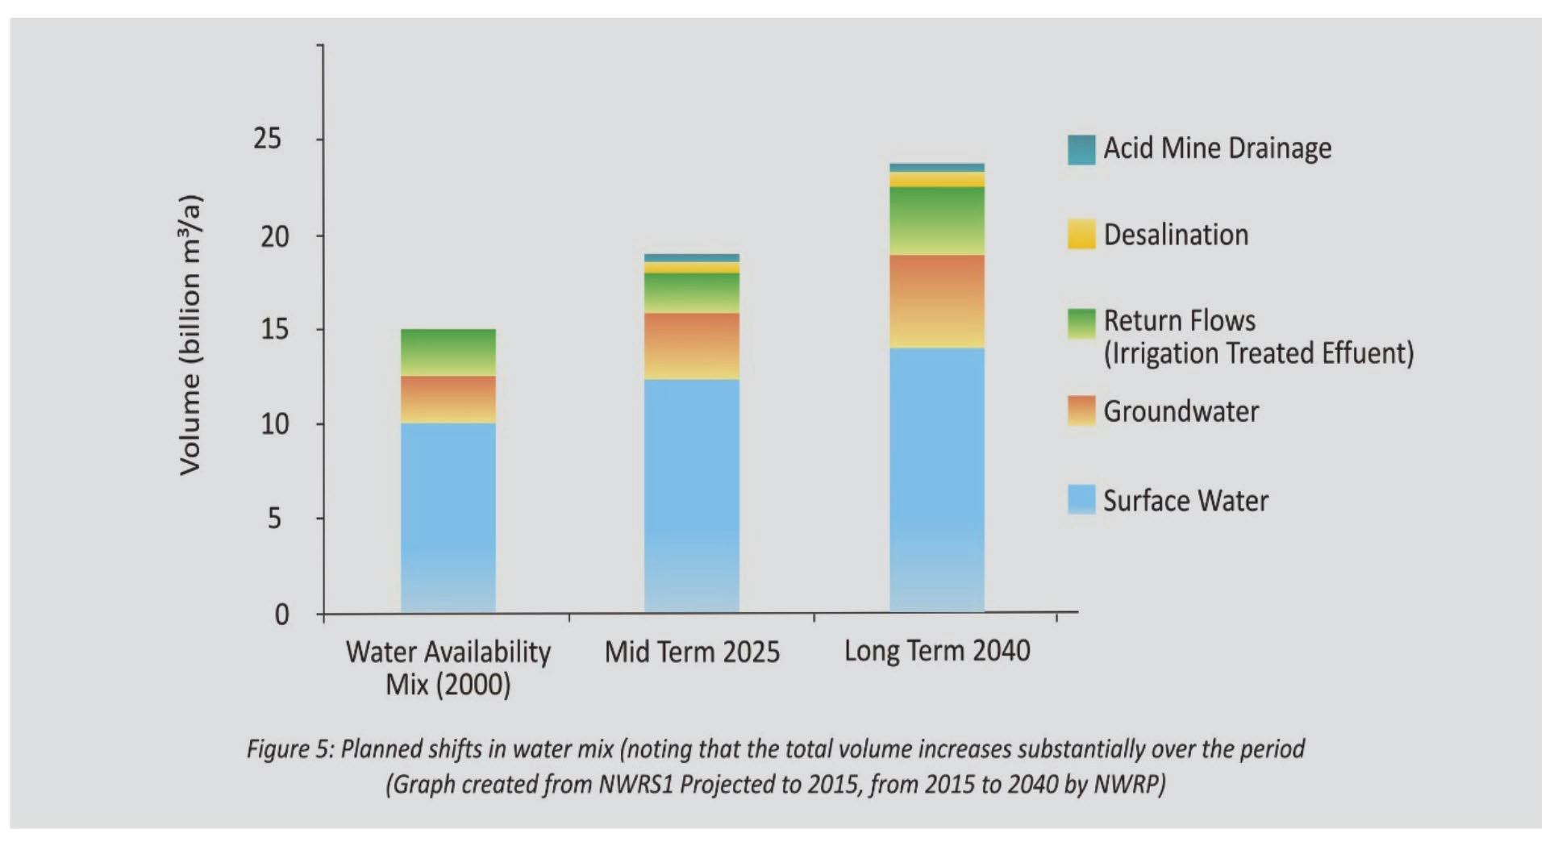
Water resource diversification
i) Supply vs Demand
2040
Water sources in South Africa – current supply

Slide 9
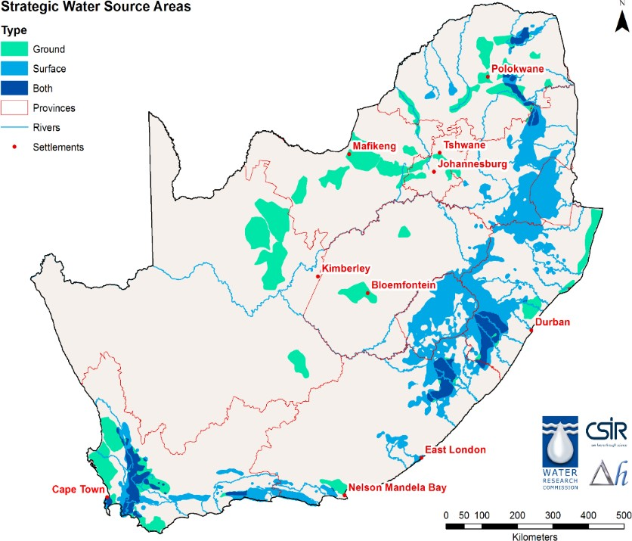
d) Threats to Water Security (Water Quantity and Quality Stressors)
ii) Uneven Distribution of Water Resources
~50% of water comes from 10% land area.
SWSA-gw method and delineation need improving
But SWSA vulnerable to land use & land cover change, pollution, climate change
Projects:
WR2012 Study
Methodology development for water resources accounting,
Update of MAP
etc
Future Project:
Dynamic water balance and water resources accounting system at sub-Quaternary catchments (Quinary catchments) for South Africa

Slide 10
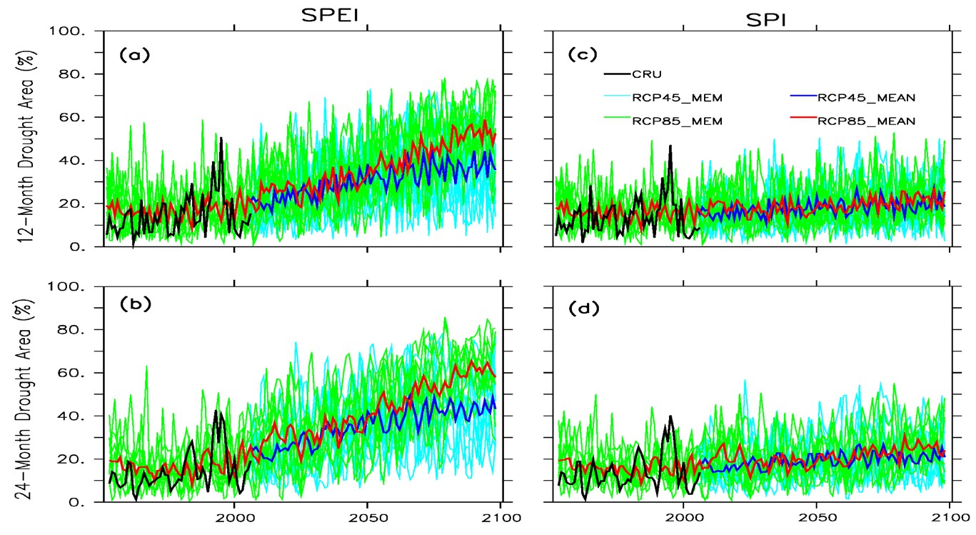
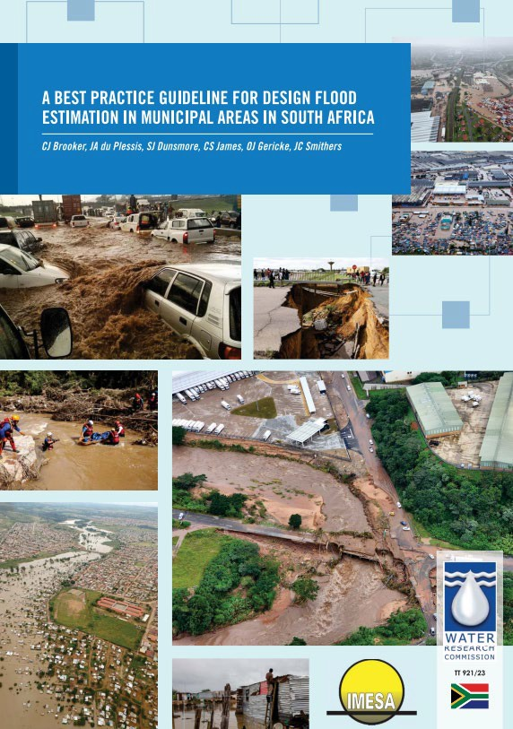
Threats to Water Security (Water Quantity and Quality Stressors)
iii) “Parched Prospects” and Intense Floods
90% of Southern Africa to experience drought with significant variability.
Projects:
Scenario-building in Limpopo RB, and Risk Framework in the Transboundary Inkomati Basin;
National Flood Studies Programme e.g. Best Practice Guidelines for Munipal Areas
etc

Slide 11
e) Conclusions
Need for downscaling: Downscaling methods are crucial to provide detailed climate information at smaller spatial scales, which is necessary for accurate climate impact studies.
Water as a key to adaptation: Reliable, clean, and diversified water resources are essential for adaptation to climate change, akin to how energy is pivotal for mitigation efforts.
Sustainable water management: Effective water management builds resilience, protects health, saves lives, and mitigates climate change by safeguarding ecosystems and reducing emissions from water and sanitation systems.
Nature-based solutions (NbS): In response to climate change-induced water insecurity, NbS enhance water availability and quality, mitigate water-related disaster risks, and support biodiversity through natural processes.

Slide 12
THANK YOU
wandilen@wrc.org.za

