Slide 1
SMART WATER MANAGEMENT APPLICATION
The Next Level of Water Management Solutions
12 September 2024
WRC Mpumalanga Provincial Partnership Support
Paseka Lesolang
paseka@whcsolutions.co.za | +27 76 772 4596

Slide 2
Company Purpose:
To serve humanity better as a contributor in the water management industry, by creating cost effective technologies that are adoptable and create a sustainable impact.
SOURCE: WHC management
1

Slide 3
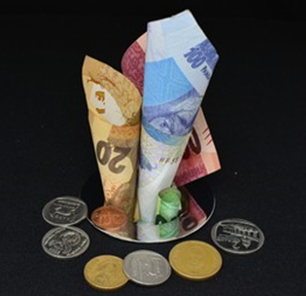
The Pain In the Market
People and municipalities loose money because of the time lapse between a water problem and fixing the problem

Slide 4
Private Use Case
1) Plumbing jobs from Clients with photos /video
Property Owners
2) Plumbers identified + Estimated quote
Material Supplier / Retailer
3) Site visit to confirm quote
4) Secure collection of material
Households
PlumbIT
5) Material Invoice
8) Payment to Hardware
Insurance
6) Job done to client’s satisfaction
9) Payment to Plumber
7) Client Pays
10) Upsell Water Efficiency + other values to client
5

Slide 5
Public Use Case
(1) Inquiries, Leak detection, Public reporting etc.
(1.2) Respond, Inform, Billing, Engage etc.
Municipality
Public / Homes
(2)
Automated Deployment of plumbers via App
(4)
Attend to the leak job and save water
Facilitating Communication
Reporting Leaks, Vandalism, Bypassing
Monitoring Water Consumption
Billing and Processing Transactions
Municipal Material Supplier / Retailer
(3) Collection of material for repairs
Accredited Plumbers
5

Slide 6
Benefits to Clients
 | Client | Value Proposition
1. | Households and property managers | Reduce water bill, save money and time
2. | Plumbers | Access more jobs through marketing and business support
4. | Retailers | Increase sales from a captive market
5. | Insurance companies | Preemptive maintenance, better due diligence, avoid water related claims
6. | Municipalities and utilities | Reduce Non-Revenue Water and improve stakeholder relations

Slide 7
Pilot Objectives:
Validate the Digi Aqua™ minimum viable product (MVP)
Test the private use case and identify areas for improvement
Generate data on user engagement, potential water savings, and plumber performance
Position Digi Aqua™ as a primary platform to allocate accredited installers
Build relationships with key stakeholders
Validate the need to develop the public use case features

Slide 8
Pilot Outcomes:
User Engagement: Promising level of user interest and platform adoption. Over 400 interactions.
Service Requests: Demonstrated a clear user demand for the services offered by Digi Aqua™.
Response and Completion Times: Service requests completed within a reasonable timeframe. i.e. within 3 hrs
Water Saving Impact: Demonstrated 80% reduction in water consumption for a homeowner after intervention.
Plumber Engagement: A sufficient number of qualified plumbers signed up and easily allocated by homeowners.
User Satisfaction: User feedback revealed an overall positive sentiment an anticipation for a public use case version to address public infrastructure plumbing issues.

Slide 9
Pilot Lessons and Recommendations:
Key Lessons Learnt:
Accept complaints as constructive criticism
Requests not offered by the solution is an opportunity
Avoid return jobs by doing it right the first time
Use every opportunity to advocate and educate
Key Recommendations:
Automate as many processes as possible
Improve the turnaround time from request to resolution
Add other services and key features
Build Public Use Case for municipalities

Slide 10
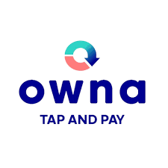
Key Strategic Partners + Roles
=> Proof of Concept
=> Technical Development Support
=> Pilot Platform
=> Material Supplier
=> User Verification
=> POS Supply
=> Customer Engagement
=> Training Plumbers
=> Plumber Accreditation
=> Promotional Support

Slide 11
SMART WATER MANAGEMENT
Toilet upgrade program and 4IR Water efficiency practices

Slide 12
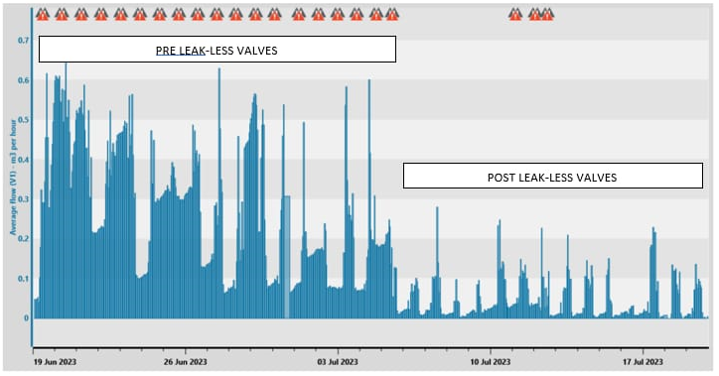
Demonstrated Success
Before Leak-Less Valve: 318L per day, per toilet
After Leak-Less Valve: 51L per day, per toilet
Daily Savings: 267L per day, per toilet
Savings Outcome: 84% decreased consumption
Monetary Savings: R3000 per year, per toilet
Payback period: Within 90 days (3 Months)
Overall Water Savings: 2 million liters p/y Overall Monetary Savings: R63 000 p/y
6

Slide 13
Successful Municipal Project
Skilled:
Youth, Women, and Men
Jobs created:
20 jobs
Installed units:
865
Water Saved to date:
Over 90 Megalitres
12

Slide 14
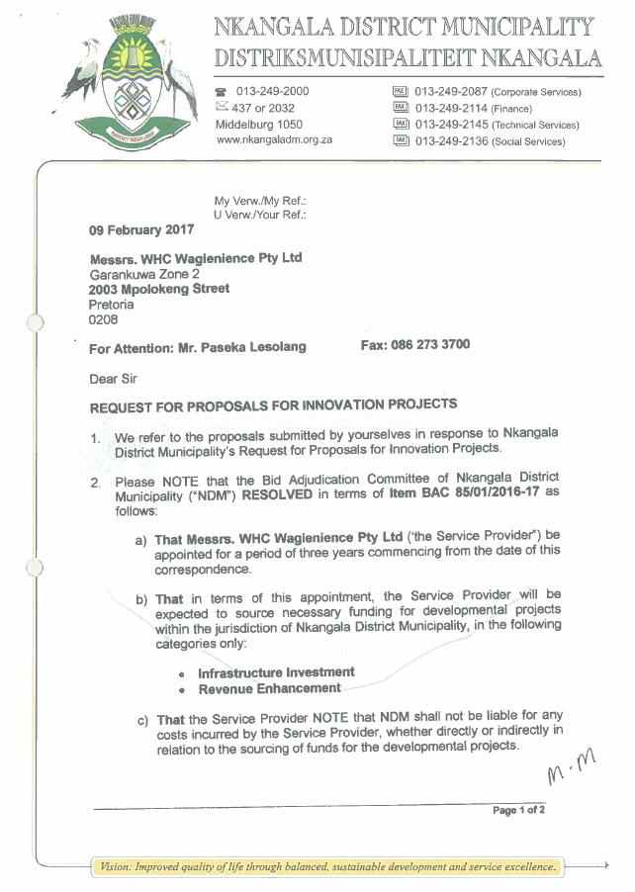
Awarded Project In Mpumalanga
To be Skilled:
Youth, Women, Men, and the Disabled
Jobs to be created:
200 jobs
Units to be Installed:
100 000
Water to be Saved:
Over 3000 Megalitres per year
Water to be Saved:
Over R20m in direct savings per year
Project Un-Activated
12

Slide 15
SMARTLOCK VANDAL PROOF UNITS
Innovative Protection Against Vandalism of Critical Water Infrastructure

Slide 16
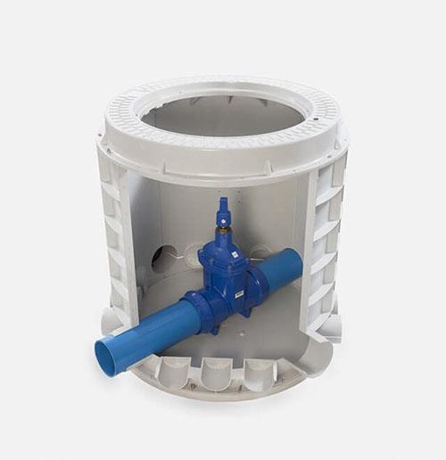
Solution
Underground centralised access management.
Authorising access requests to remote locations
Exact location of on site personnel.
Secure mobile communication keys i.e. Bluetooth.
Addresses all the functional requirements [vandal proof]
Access control and monitoring of water and sanitation infrastructure, manholes, pump stations, critical equipment i.e. Transformers, Monitoring points etc.

Slide 17
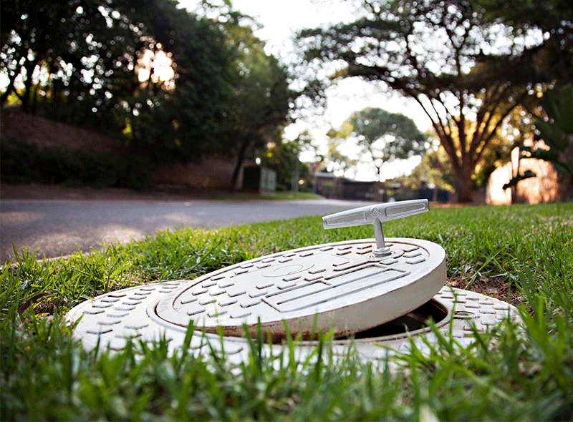
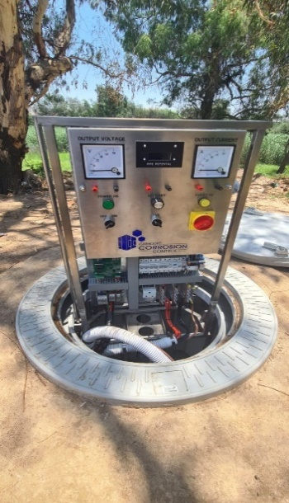
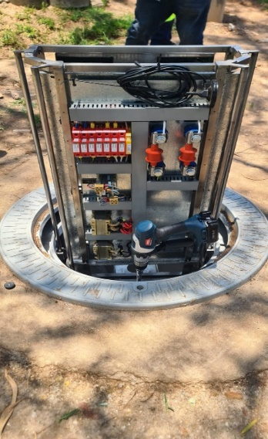
Value
Barrier against crime
No scrap resell value
Load-bearing capability for assorted utility infrastructure
Very Durable; 40 years’ service lifespan
Electronic locking and monitoring
Control in authorising access to infrastructure
Detect and record geographical locations of all access points
Complete and validated geographical asset record
Market-leading performance in ergonomics
Bluetooth
Key activated
Per authorized
Site and
Personnel
Critical
Infrastructure
Safely secured
Underground and
Elevated when
Required
Easy Access
To infrastructure
For Authorized
Personnel
Alarms and Alerts
Upon temper
Attempts by
Unauthorized
People

Slide 18
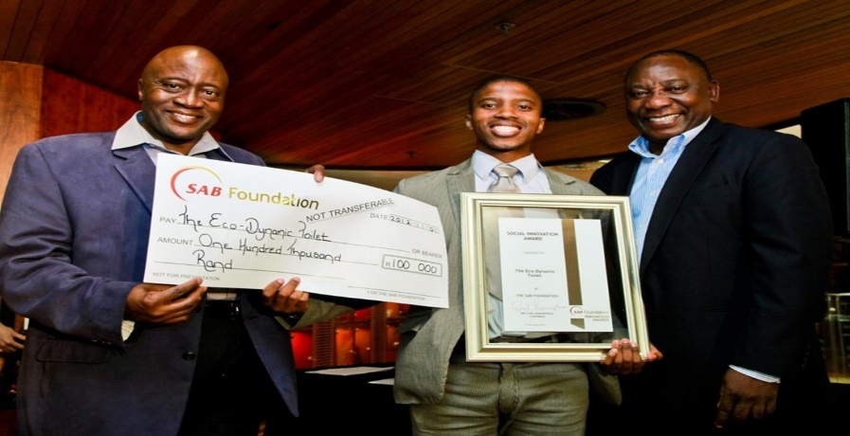
2010 Most Innovative Product – Maker Faire Africa, Kenya
2012 JCI Best Business Plan 1st Prize Winner – South Africa
2012 Innovative Social Entrepreneurship – SAB Foundation
2012 JCI Creative Young Entrepreneurship Award – Taipei, Taiwan
2013 one of 3 innovators selected in Africa for RAN – Silicon Valley, USA
2014 Technology Top 100 Company Winner
2015 Standard Bank Water4Africa Competition Judge
2015 Top 3 Most Disruptive & Promising Start-up in the World – Spain
2015 Green City Startup Winner
2017 Top 100 Youth Innovator of the Year
2018 Global Cleantech Innovation Programme Alumni Leader
2019 Premier Service Excellence Award for Innovation
2021 Best 4IR Aquatech Innovation Advert
2022 Mandela Washington Fellow – USA
2022 Technology Top 100 Company 5 x Award Winner
2022 EWSETA Water Innovation Awards 1st Prize Winner
2023 Global Exporters Accelerator Programme (GEAP) Innovation Award
2023 South African Innovation Awards 1st Prize Winner
Awards and Honours

Slide 19
Paseka Lesolang | paseka@whcsolutions.co.za | +27 76 772 4596
37

