Slide 1
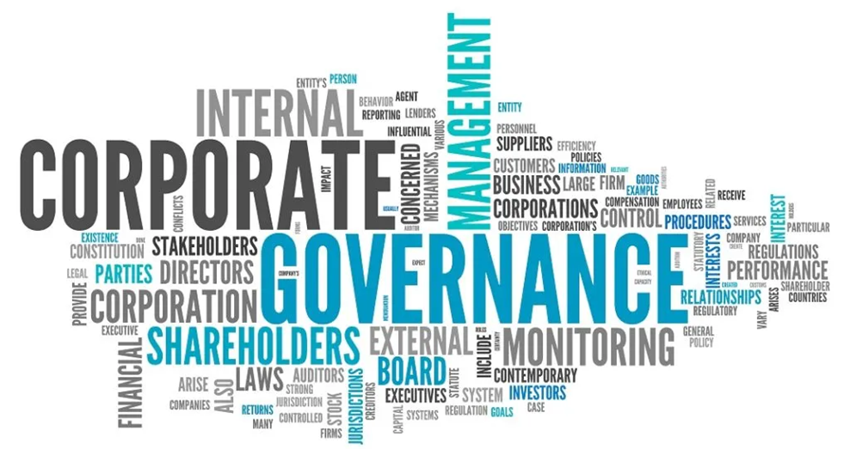
WRC 101
Leading the Water Innovations Space

Slide 2
The Global Risk Landscape 2020 – Impact (y) versus Likelihood (y)
[WEF Global Risks Report 2020]

Slide 3
The Global Risk Landscape 2020 – Impact (y) versus Likelihood (y)
[WEF Global Risks Report 2020]

Slide 4
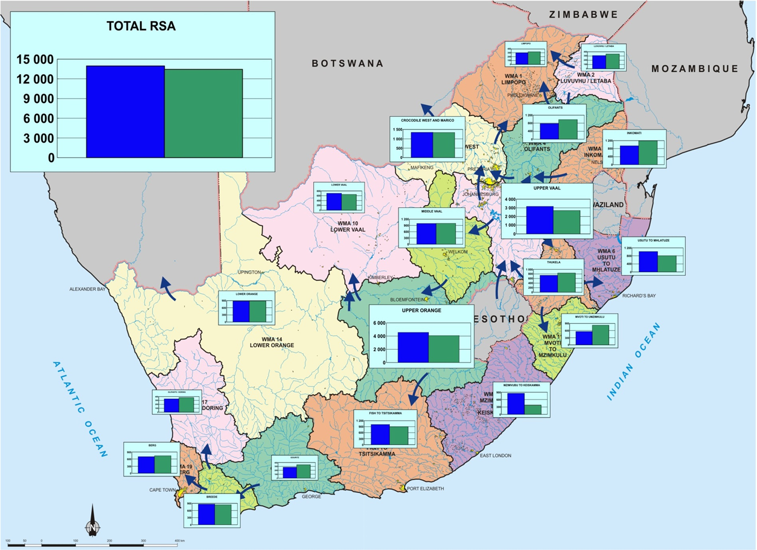
The Global Risk Landscape 2020 – Impact (y) versus Likelihood (y)
[WEF Global Risks Report 2020]

Slide 5
The Global Risk Landscape 2020 – Impact (y) versus Likelihood (y)
[WEF Global Risks Report 2020]
Promoting co-ordination, co-operation and communication in the area of water research and development
Establishing water research needs and priorities
Stimulating and funding water research according to priority
Promoting effective transfer of information and technology
Enhancing knowledge and capacity building within the water sector

Slide 6
The Global Risk Landscape 2020 – Impact (y) versus Likelihood (y)
[WEF Global Risks Report 2020]

Slide 7
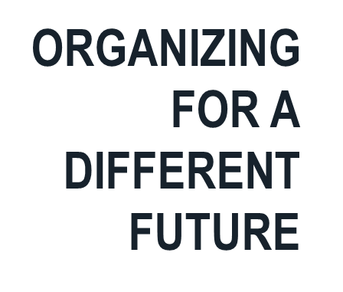
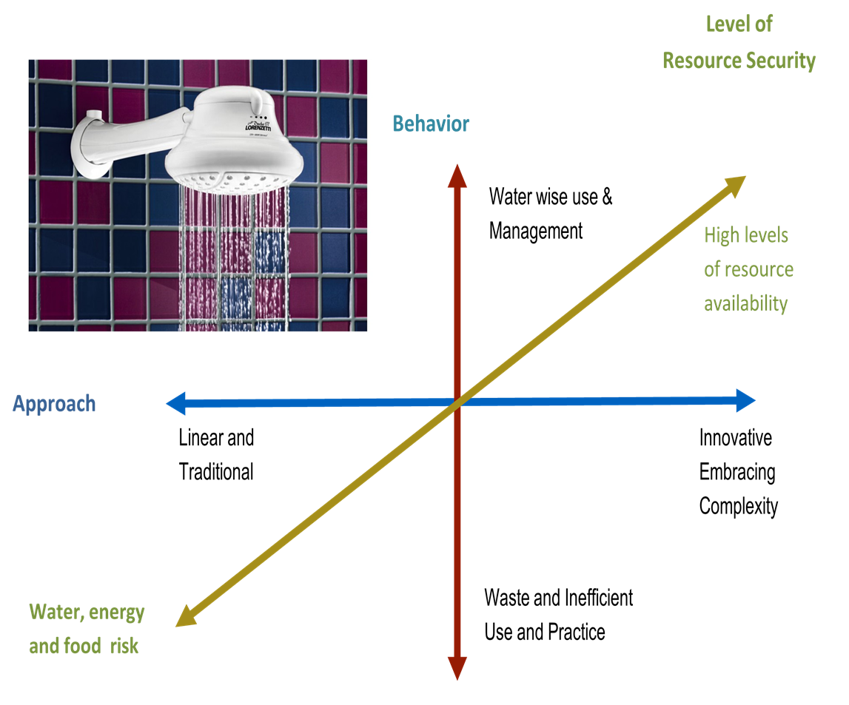
The Global Risk Landscape 2020 – Impact (y) versus Likelihood (y)
[WEF Global Risks Report 2020]

Slide 8
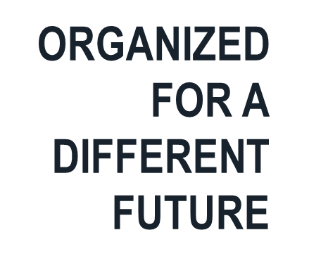
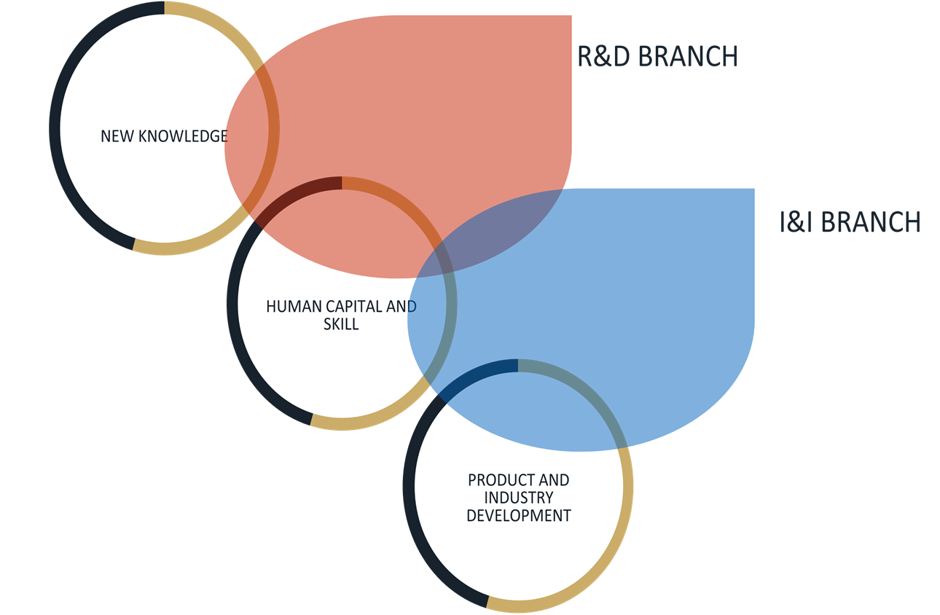
The Global Risk Landscape 2020 – Impact (y) versus Likelihood (y)
[WEF Global Risks Report 2020]

Slide 9
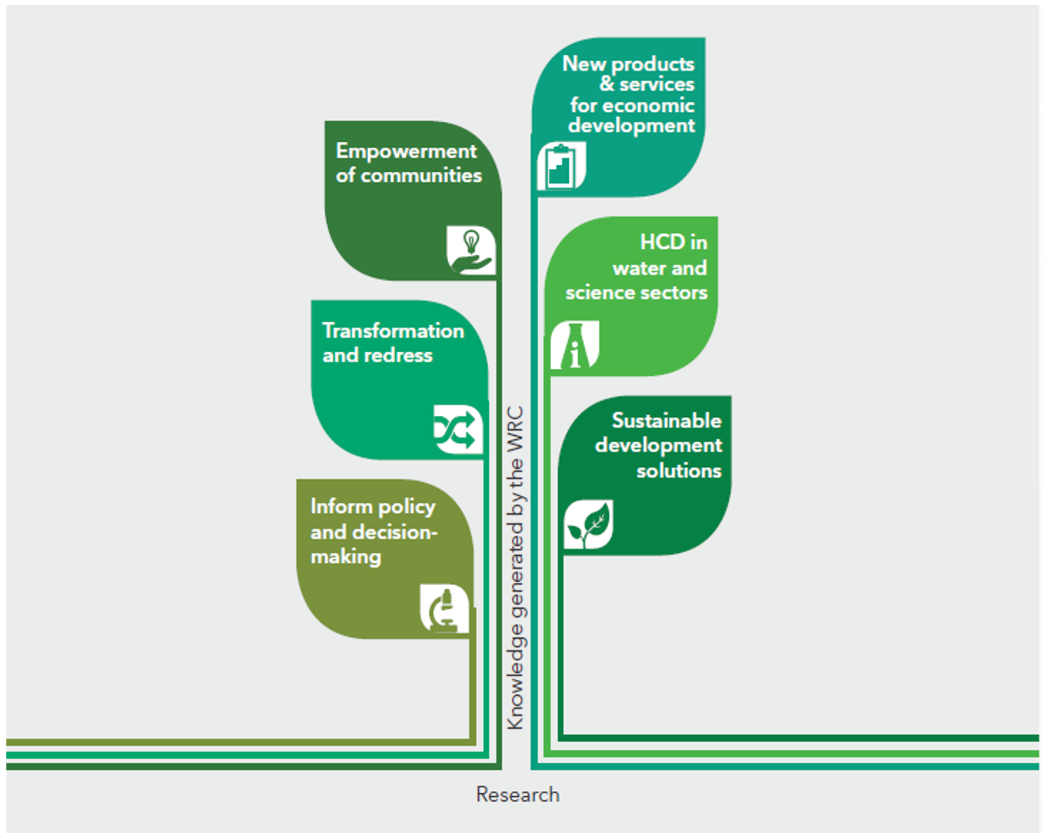
The Global Risk Landscape 2020 – Impact (y) versus Likelihood (y)
[WEF Global Risks Report 2020]
The strategy is implemented through the WRC Knowledge Tree

Slide 10
Socio-Economic Impact
Organizing for Greater Impact
Conceptual Impact
Instrumental Impact
Academic Impact

Slide 11
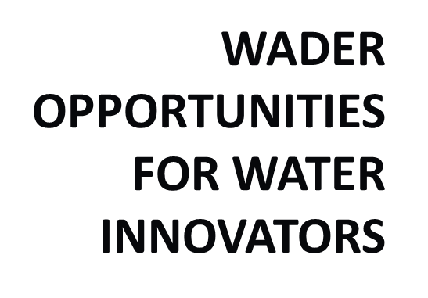
The Global Risk Landscape 2020 – Impact (y) versus Likelihood (y)
[WEF Global Risks Report 2020]

Slide 12
The Global Risk Landscape 2020 – Impact (y) versus Likelihood (y)
[WEF Global Risks Report 2020]
Thank You

